Slide 1



Slide 2



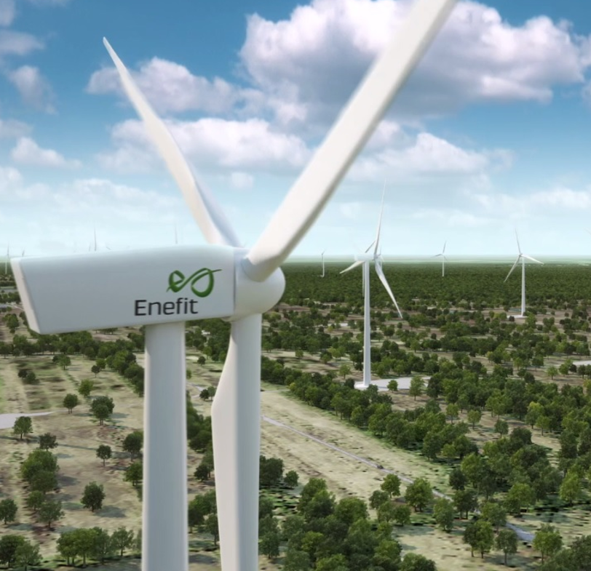

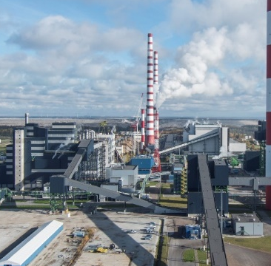
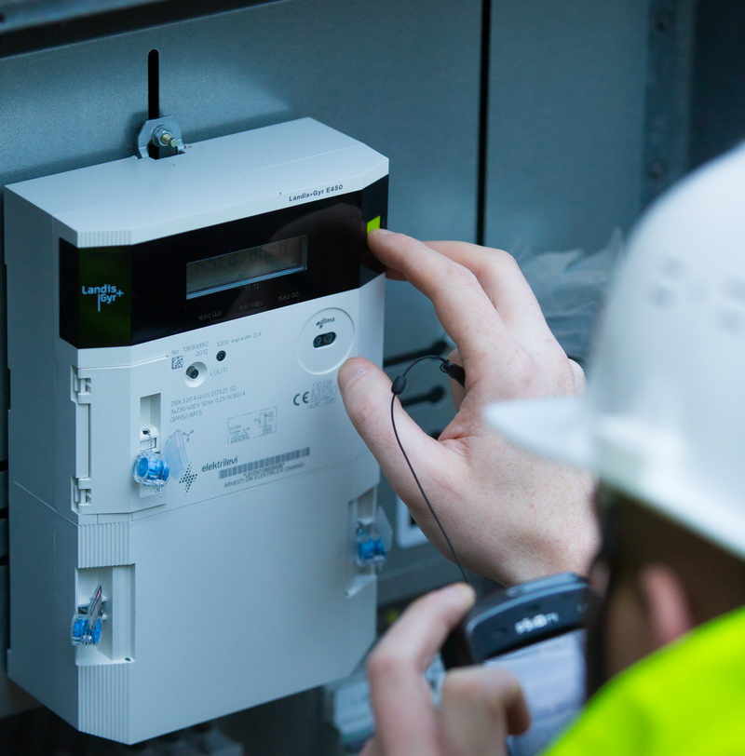
  Established in 1939
  5800 employees
  25 subsidiaries and related companies
  6 home markets
  2.500 million EUR investments during the last 10 years
  Group's net profit in 2017: 101 million EUR
  Sales revenues of the group in 2017: 754 million EUR
Customer
Services
Renewable
Energy
R&D
Large Scale
Energy Production
Network
Services

Slide 3

The DNA of Eesti Energia/ Enefit
Uniqueness in Estonia:
Close to 80 years of experience in Estonia
One of Estonia's most well-known brands
The largest employer
One of the biggest customer bases
Existing oil shale mining permits
The operation of renewable energy technologies
The combination of new and existing technologies in the large-scale power industry
Nationwide network infrastructure
International uniqueness:
The digitalization of client services and the network service
Oil shale know-how based on a 100-year experience

Slide 4
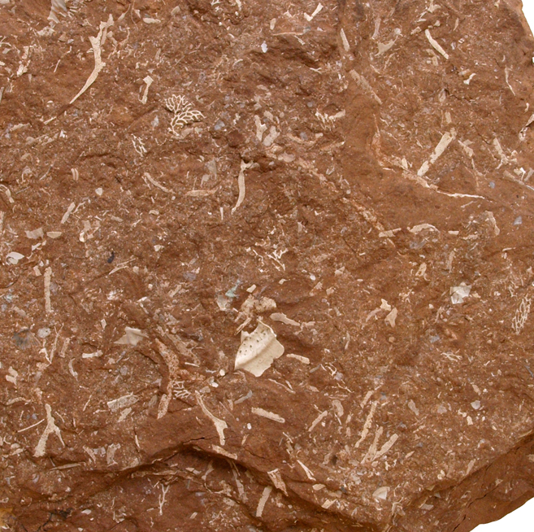

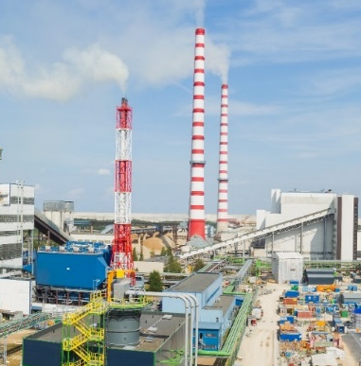
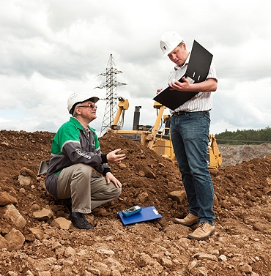
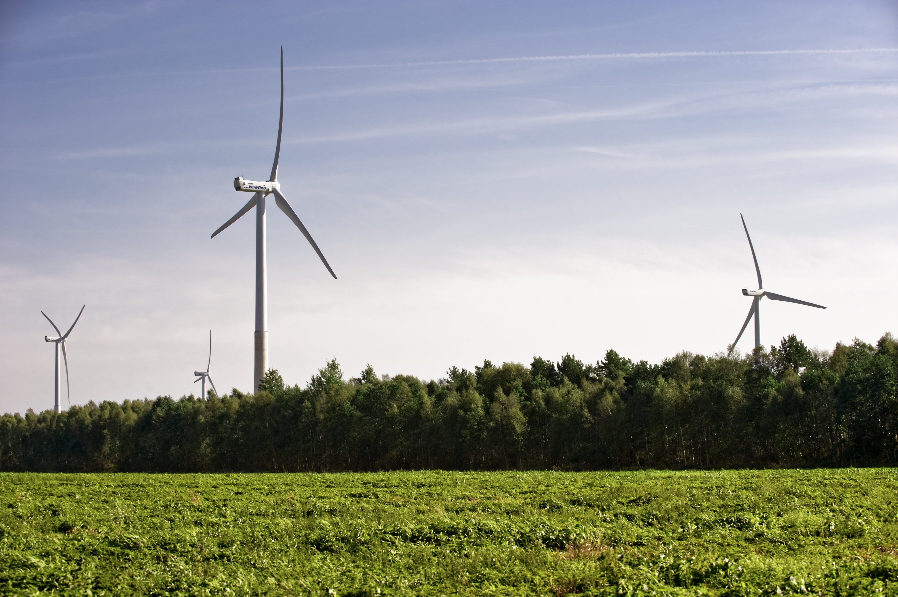
The expectations towards us
To add maximum value to oil shale related know-how
To increase the value of the company and ensure stable dividend income
To ensure the security of supply of electricity in Estonia
To utilize the regional workforce
To reduce negative environmental impacts

Slide 5
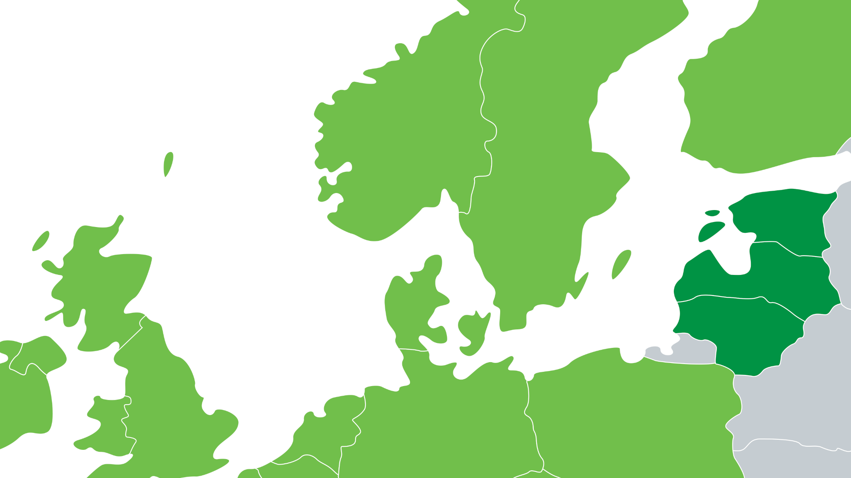


New power cables integrate us with larger market areas
83 TWh
33€/MWh
132 TWh
29 €/MWh
Fenno Skan 1,2
1300 MW
138 TWh
31€/MWh
Estlink 1,2
1000 MW
North Connect
1400 MW
8 TWh
33 €/MWh
NordBalt
700 MW
7 TWh
35 €/MWh
North Sea Link
1400 MW
348 TWh
52 €/MWh
Nord.Link
1400 MW
SWE - POL
600 MW
LT - KAL
600 MW
9 TWh
35€/MWh
LT - POL
500 MW
LT - Belarus
1350 MW
161 TWh
37 €/MWh
493 TWh
34 €/MWh
New cables
Data 2017

Slide 6





Vattenfall, Sweden
127.3 TWh
400 TWh
The single Nordic and Baltic electricity market
A TOTAL OF NEARLY 400
PRODUCERS
Total of Eesti Energia
9.7 TWh
4Energia
0.8 TWh
Enefit Green
0.4 TWh
Latvenergo, Latvia
5.7 TWh
Fortum, Finland
73 TWh
Lietuvos Energia, Lithuania
1.28 TWh
Statkraft, Norway
63 TWh

Slide 7
2018–2022
STRATEGIC GOALS
Client services
Renewable energy
We provide energy solutions for 1 million customers in the Baltic Sea region by helping them use energy in a smarter and cleaner way.
Electricity produced from renewable and alternative sources will form 40% of our production in the Baltic Sea region.
Developments
Energy solutions to customers, new renewable energy production units, new Enefit 280 oil factory, raising the quality of liquid fuels, the export of know-how
Large-scale power industry
Network services
The oil shale industry will develop to a contemporary large-scale power industry, where production is large-scale, controllable and uses various sources of energy.
We focus on ensuring the reasonable availability and price of the network service and the joint management of infrastructures.

Slide 8

Customer services

Slide 9

CUSTOMERS' EXPECTATIONS ARE CHANGING
Increasing consumption
Electrical mobility
Micro-production
Energy savings
Customers' consumption of electricity will increase: heating systems, ventilation, storage units
Increase in the number of electric cars creates a demand for services in the nation-wide recharging network and at customers' places of consumption
An increasing number of customers will become electricity producers
In 2020-2021, requirements to nearly zero-energy buildings taking effect will create a market for new services
Notes:
Jällegi näide, kuidas kasutame

Slide 10

Renewable energy

Slide 11
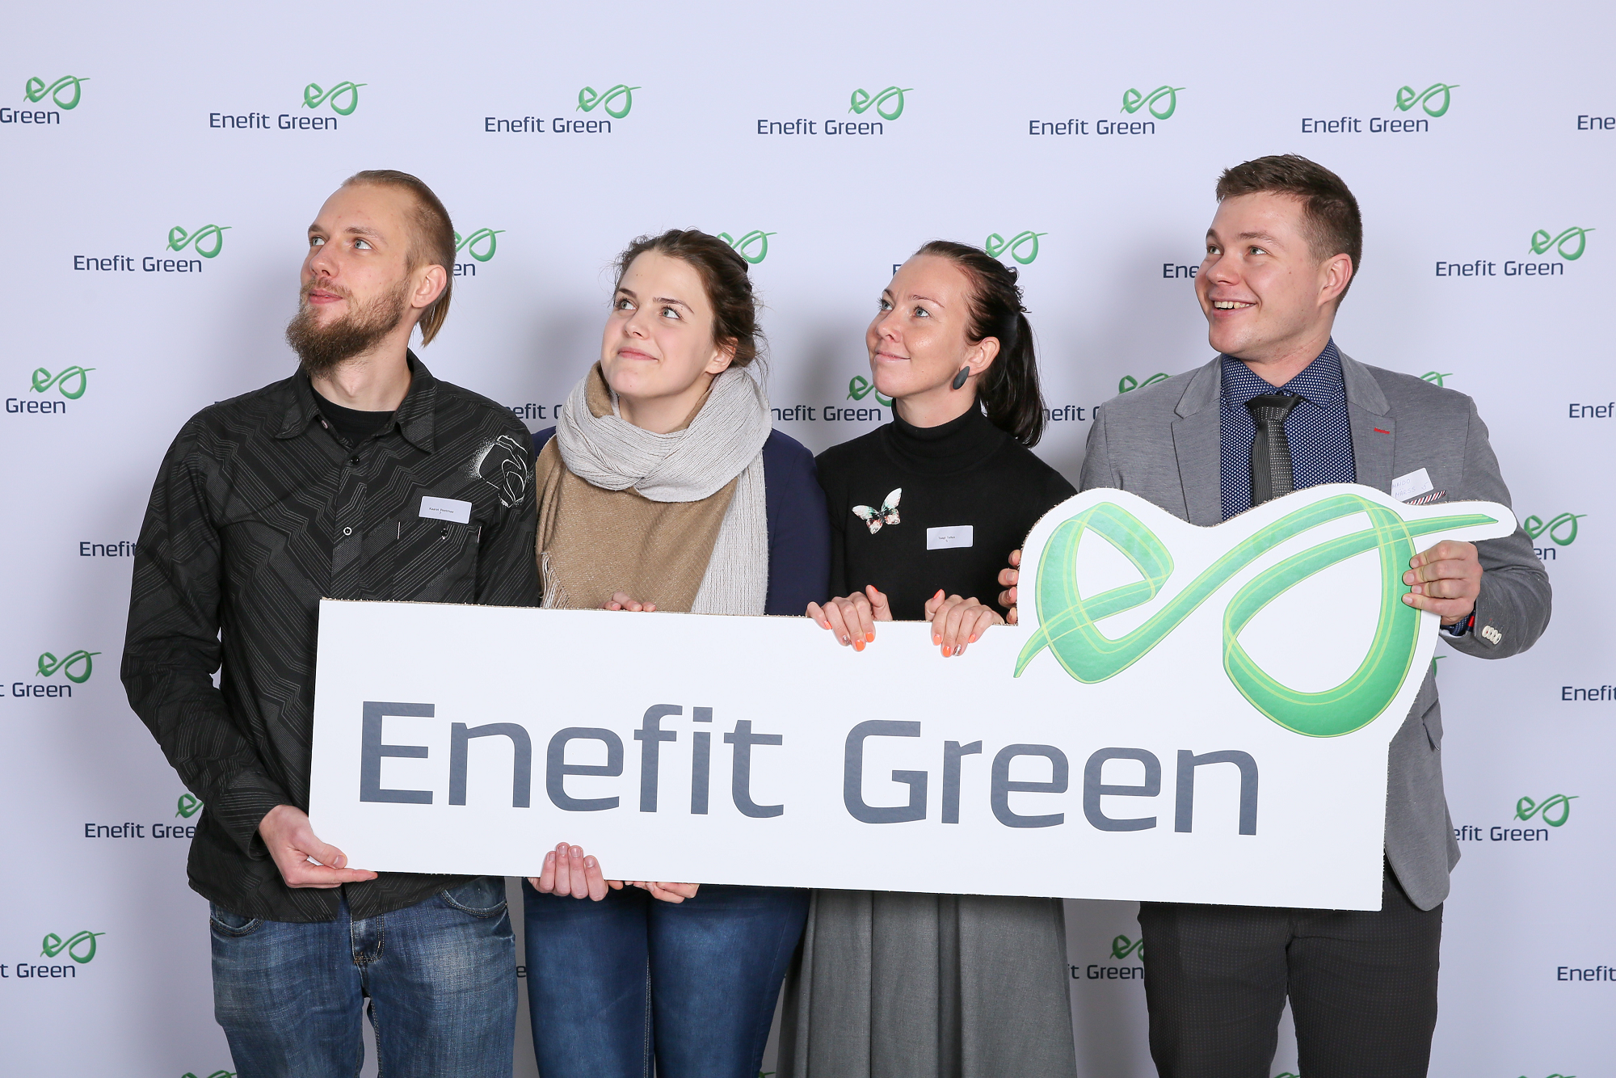
Eesti Energia Group's renewable energy production has been merged to the subsidiary Enefit Green
Wind power is the foundation of our growth, Enefit Green has a 16-year long experience, which we use for establishing wind farms in Estonia and in new markets
Solar power is the future for which we are preparing already today. The first solar power stations in Estonia have been completed
We focus on the efficient use of our assets. We are ready to invest in new projects

Slide 12

Large-scale power industry

Slide 13
TRANSITION TO CLEANER TECHNOLOGIES
Technological development
Regulation
Resource
Market
Inland wind turbines and Enefit280 oil and electricity production are able to compete with current market prices
New resource taxes 2019 and pollution charge rates 2020, CO2 price increase, stricter requirements for the sulphur content of liquid fuels from 2020
New division principles for oil shale resource 2019
2018–2022 a moderate rise in the market prices of electricity and liquid fuels, taxation of imported electricity from third countries, pressure for salary increase

Slide 14

Large-scale power industry in 2022
We will increase the production volume of liquid fuels
to 460 thousand tons per year
Increase the amount of electricity produced from oil shale gas
Produce at least 1.4 TWh of electric power from biomass and participate in the statistics trade
Produce liquid fuels from used tyres
and this way clean up Estonian forests
Flexible production assets operation
Build up an efficient asset management unit
Continue the digitalization of the industry, because it helps to ensure fuel quality, control production assets and asset management

Slide 15

Developments
2018-2022

Slide 16

The role of developments in Eesti Energia
The management of Group's strategic development projects
Identification and development of new opportunities via the Idea Bank
Export of oil shale related know-how
Development of Group's project management and partner relations

Slide 17

Network services

Slide 18

REGULATED NETWORK SERVICE COMPETES WITH NEW TECHNOLOGIES
Technological development
Expectations to the network company
Regulation
The digitalization of the industry increases energy consumption and demand for fast communication connections, increase in distributed production, the development of remote administration technology, price cut in battery technology, increase in the number of electric cars
Preferential development of renewable energy, energy efficiency targets, tendency for joint utilization of infrastructures, the need for long-term tariff strategy design deepens
New customers' expectations on services, incl. in terms of alternative solutions, expectation for service price cut

